Slide 1
Language technology for low-resource languages
Day 4/5
LOT 2018, Groningen
Yves Scherrer, University of Helsinki

Slide 2
Data transfer and model transfer
How do the different methods handle the following characteristics?
Word order differences between HRL and LRL
Polysemy/homonymy in HRL/LRL
False friends
Grammatical categories not present in HRL/LRL

Slide 3
Closely related languages
If the LRL is closely related to the HRL, how does this simplify...
... the use of data transfer methods?
... the use of model transfer methods?

Slide 4
Closely related languages
Data transfer is easier
Parallel corpora for projection are “more parallel”
Training data translation can be done word-by-word or character-by-character
Model transfer works better
Larger number of identical words, so plain model transfer works
Assumptions about constant word order are more realistic
Cognate matching instead of bilingual lexicon induction

Slide 5
Case studies
Training data translation
Czech -> Slovak
Test data backtranslation
Modern Slovene <- historical Slovene
Standard German <- Alsatian
Standard German <- Swiss German
Plain model transfer
Slovak, Polish, Ukrainian, Russian -> Rusyn
Relexicalization
Cognate matching, various language configurations
Delexicalization with character embeddings
Various language configurations

Slide 6
Treebank translation for closely related languages
VarDial 2017 shared task on cross-lingual parsing
Take a Czech treebank
Translate it to Slovak word by word
No unaligned words, no dummy nodes to process
Borders between treebank translation and relexicalization are somewhat blurry...
Train a parser on the “slovakified” data
 | LAS | UAS
Plain model transfer | 53.72 | 65.70
Treebank translation | 64.05 | 73.16
Supervised model | 69.14 | 76.57

Slide 7
Treebank translation for closely related languages
Universal dependency annotations are not harmonized (enough) across languages
The Czech treebank has a nummod:gov dependency relation, the Slovak dev data only has nummod.
The Czech treebank distinguishes DET and PRON, the Slovak dev data does not.
Also train a new Slovak POS tagger on translated data to provide the parser with consistent input features

Slide 8
Treebank translation for closely related languages
Results:
 | LAS | UAS
Plain model transfer | 53.72 | 65.70
Treebank translation | 64.05 | 73.16
Treebank translation with harmonization and cross-tagging (+ other improvements) | 78.12 | 84.92
Supervised model | 69.14 | 76.57

Slide 9
Treebank translation for closely related languages
Using a cross-lingual transfer method yields better results than a supervised model!
Czech treebank: 68 000 sentences
Slovak treebank: < 10 000 sentences
Similar, although not as spectacular results for Croatian and Norwegian
M. Zampieri et al. (2017): Findings of the VarDial Evaluation Campaign 2017. Proceedings of VarDial 2017.
Rudolf Rosa et al. (2017): Slavic Forest, Norwegian Wood. Proceedings of VarDial 2017.

Slide 11
Test data backtranslation for historical varieties
Historical Slovene text from 1750-1900
How can we tag/lemmatize the historical data?
Tagger and lemmatizer for modern Slovene are available
Lemmatization = associate historical word form with modern lemmas
Y. Scherrer Y & T. Erjavec (2016): Modernising historical Slovene words. Natural Language Engineering 22(6), 881-905.

Slide 12
Test data backtranslation for historical varieties
Original:
Plain model transfer, apply modern models to historical data without modification
Normalization:
Apply some rules to transform historical spelling to modern spelling, then apply modern models
Modernization:
Learn character-level machine translation model on parallel data, then modernize all historical data, and apply modern models

Slide 13
Test data backtranslation for historical varieties
Three sub-periods:
1750-1800
1800-1850 (pre spelling reform)
1850-1900 (post spelling reform)

Slide 14
Test data backtranslation for historical varieties
Three sub-periods:
1750-1800
1800-1850 (pre spelling reform)
1850-1900 (post spelling reform)
Tagging
Lemmatization
 | 1750 | 1800 | 1850 | 1750 | 1800 | 1850
Original | 27.9 | 53.0 | 80.8 | 7.7 | 17.2 | 80.4
Normalized | 41.6 | 72.3 | 81.5 | 22.7 | 57.3 | 82.1
Modernized | 64.1 | 77.0 | 82.3 | 57.4 | 68.5 | 84.3

Slide 16
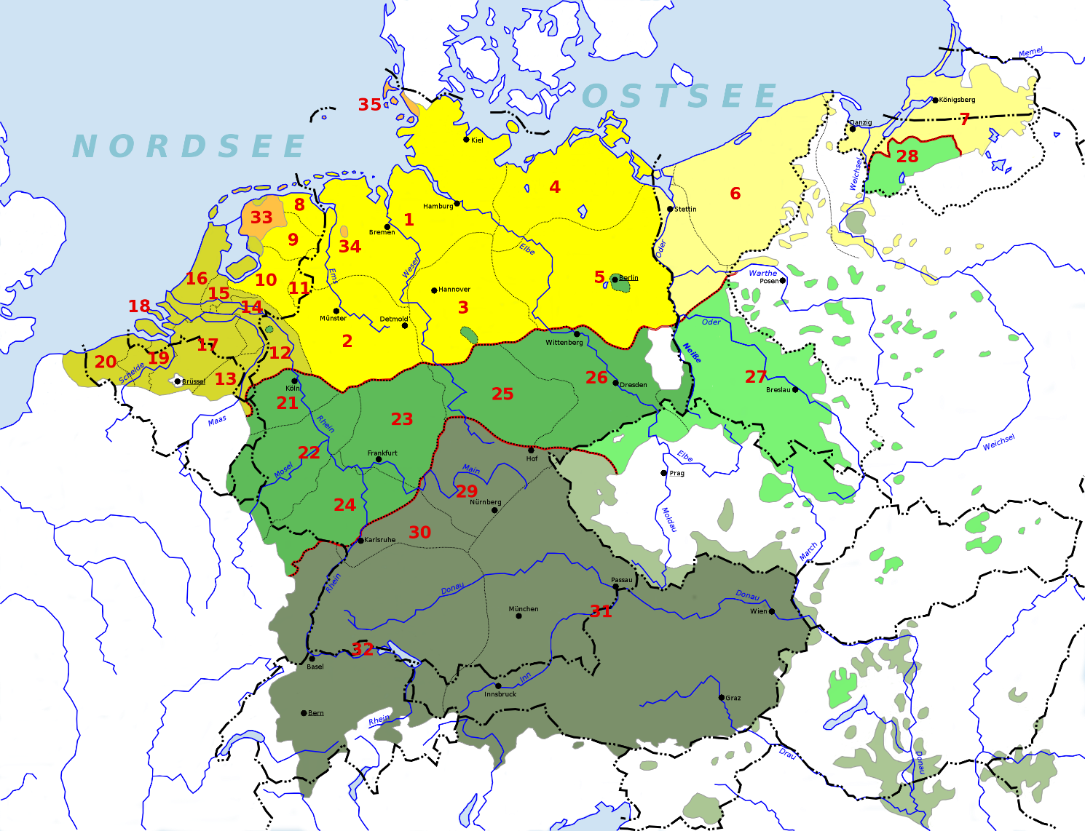
Test data backtranslation Alsatian

Slide 17
Alsatian
German dialect (High German / Alemannic) spoken in France
Several dialectal variants, no standardized spelling
Minority language (normative pressure from French), few available resources
Delphine Bernhard & Anne-Laure Ligozat: Hassle-free POS-Tagging for the Alsatian Dialects. In Marcos Zampieri & Sascha Diwersy: Non-Standard Data Sources in Corpus Based-Research, Shaker, 85-92, 2013, ZSM Studien.

Slide 18
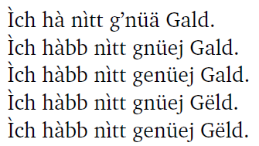
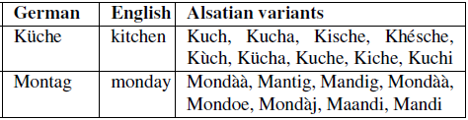
Alsatian
Ich habe nicht genug Geld.
I don’t have enough money.

Slide 19
Tagging Alsatian
Plain model transfer:
Apply Standard German tagger on Alsatian data
Example:
Words in red are identical in Standard German
Text | TreeTagger | Stanford Tagger
Alsace [news] | 48% | 56%
Duttlenheim [theater] | 67% | 77%
Hoflieferant [theater] | 64% | 67%
Wikipedia | 50% | 53%

Slide 20
Tagging Alsatian
Translate the 107 most frequent Alsatian word forms to German:
Text | TreeTagger | Stanford Tagger | Translated tokens
Alsace | 79% (+31%) | 86% (+30%) | 32%
Duttlenheim | 86% (+19%) | 88% (+11%) | 19%
Hoflieferant | 78% (+14%) | 82% (+15%) | 17%
Wikipedia | 83% (+33%) | 85% (+32%) | 36%

Slide 21
Tagging Alsatian
Plain model transfer is not enough
Even when languages are closely related
48%-77% accuracy for tagging
Manual annotation (translation) of about 100 high-frequency words helps a lot:
48% → 79%, 77% → 88% accuracy
Recall unrelated languages: 2h of annotation ≈ 1000 word/tag pairs
The most frequent words help most. Influence of additional words decreases with decreasing frequency.
Not only the translated word forms are tagged more correctly, also their surroundings.

Slide 23
Tagging Swiss German
The ArchiMob corpus:
Transcribed video interviews in various Swiss German dialects
Goal: part-of-speech tagging
Available training resources:
TüBa-D/S: spontaneous dialogues, Standard German, 360k tokens
NOAH: Swiss German news articles, not the same transcription guidelines, 73k tokens
What is the best way to tag the ArchiMob data?
T. Samardzic et al. (2016). ArchiMob - A Corpus of Spoken Swiss German. Proceedings of LREC 2016.

Slide 24
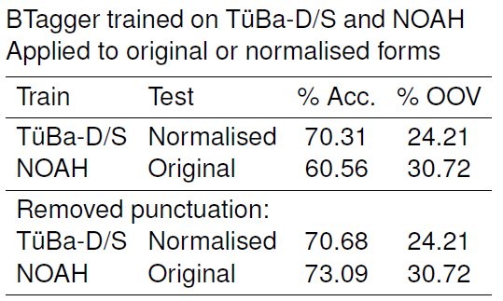
Tagging Swiss German
Normalization: learn a character-level machine translation on hand-normalized data

Slide 25
Tagging Swiss German
We don’t need to learn how to tag punctuation signs, as they don’t occur in the ArchiMob transcriptions...

Slide 26
Tagging Swiss German
This is a negative result for cross-lingual learning methods...
Using test data backtranslation (=normalization) does not work better than a supervised model, even though the genre and transcription guidelines of the supervised model are different!

Slide 27
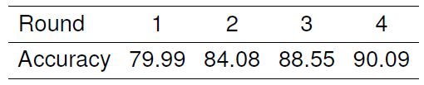
Tagging Swiss German
Further improvements:
Annotate a document
Hand-correct the annotations
Add the corrected document to the training data
Train a new tagger and repeat

Slide 28
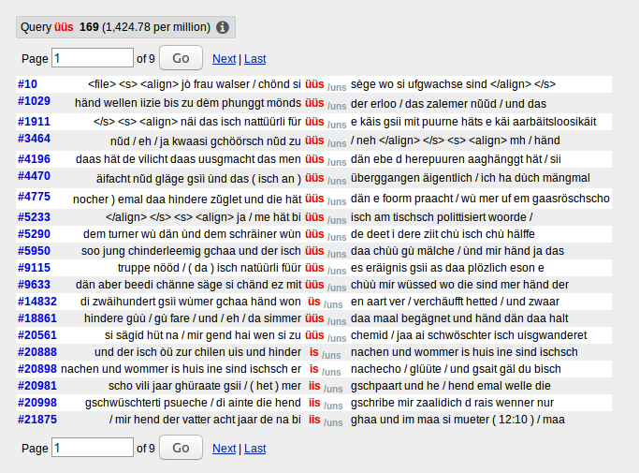
Normalizing Swiss German
Normalization may not be useful for tagging, but can we use it for other purposes?
Dialect-independent search

Slide 29
Normalizing Swiss German
Normalization may not be useful for tagging, but can we use it for other purposes?
We can create a distinct normalization system for each document
The normalization systems are character-level statistical machine translation systems, so transformations are stored in phrase tables
Hypothesis: certain phrase pairs show regionally different frequency distributions

Slide 30
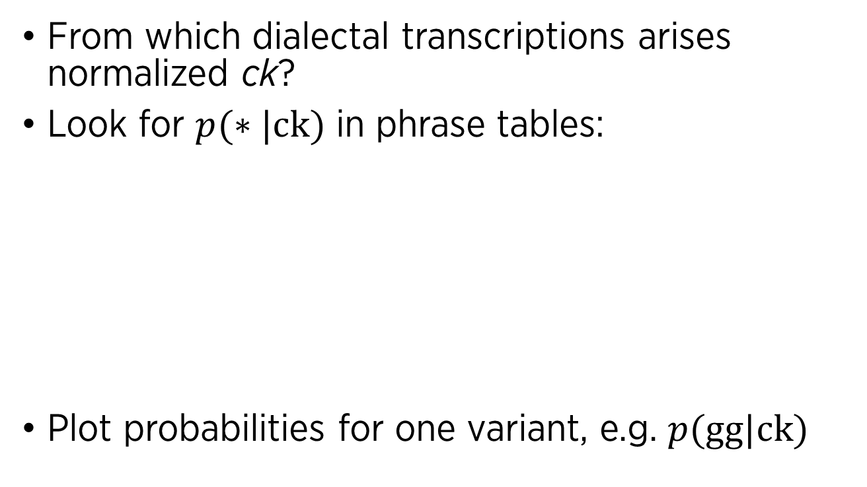
Normalizing Swiss German
From which dialectal transcriptions arises normalized ck?
Look for $p(∗|\text{ck})$ in phrase tables:
Plot probabilities for one variant, e.g. $p(\text{gg}|\text{ck})$
Transcription -> Normalization | Document 1 | Document 2
k -> ck | 37.0% | 95.2%
gg -> ck | 63.0% | 2.4%
ch -> ck | 0% | 2.4%

Slide 31
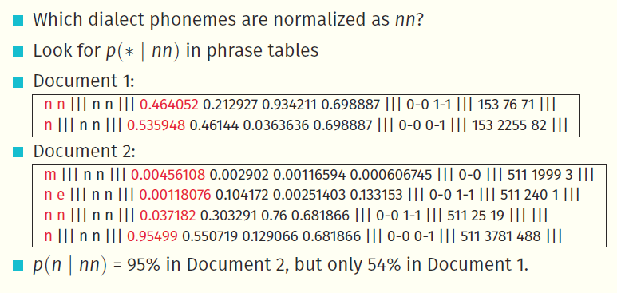
Normalizing Swiss German

Slide 32
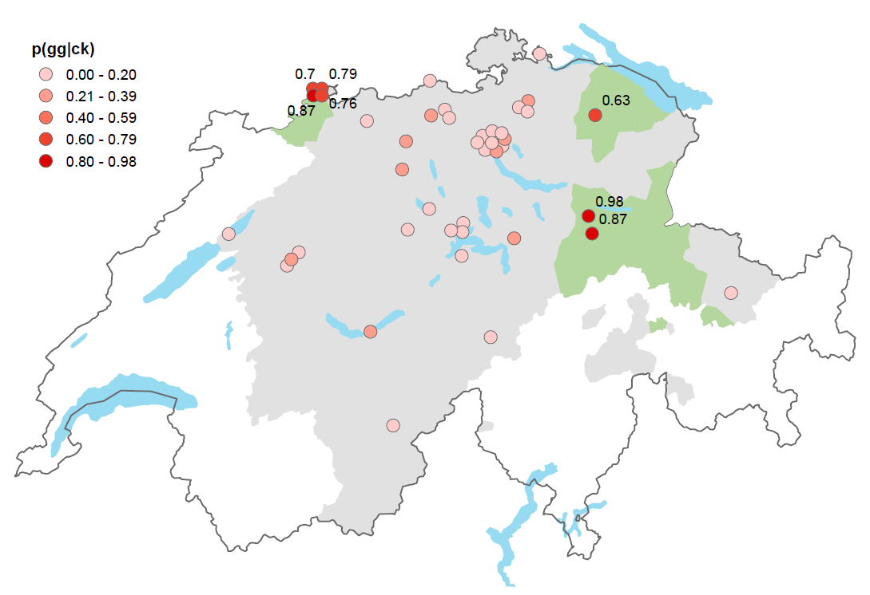
Normalizing Swiss German
Green areas:
Use of /gg/ reported by a dialect atlas

Slide 33
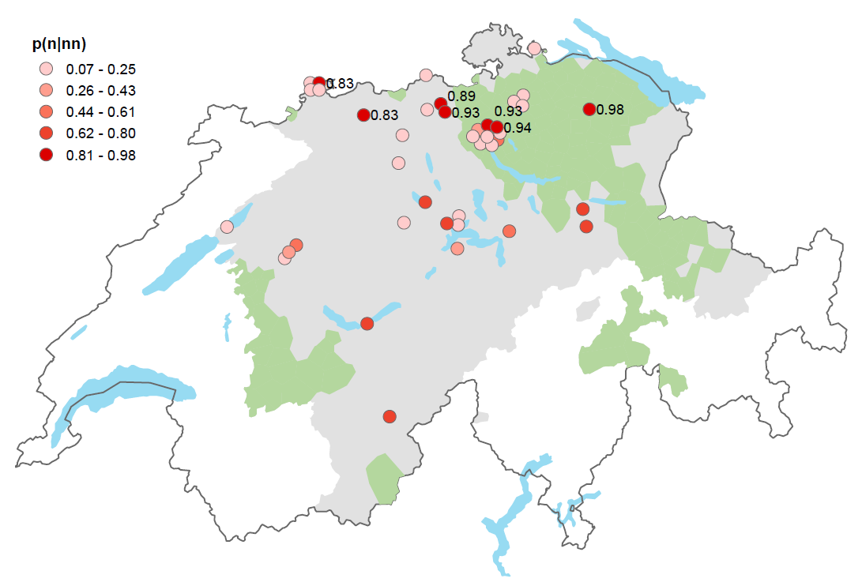
Normalizing Swiss German

Slide 34
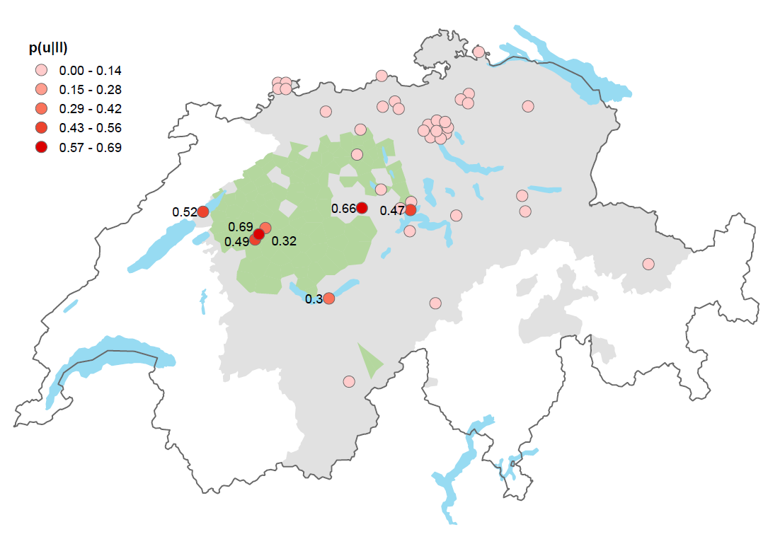
Normalizing Swiss German

Slide 36
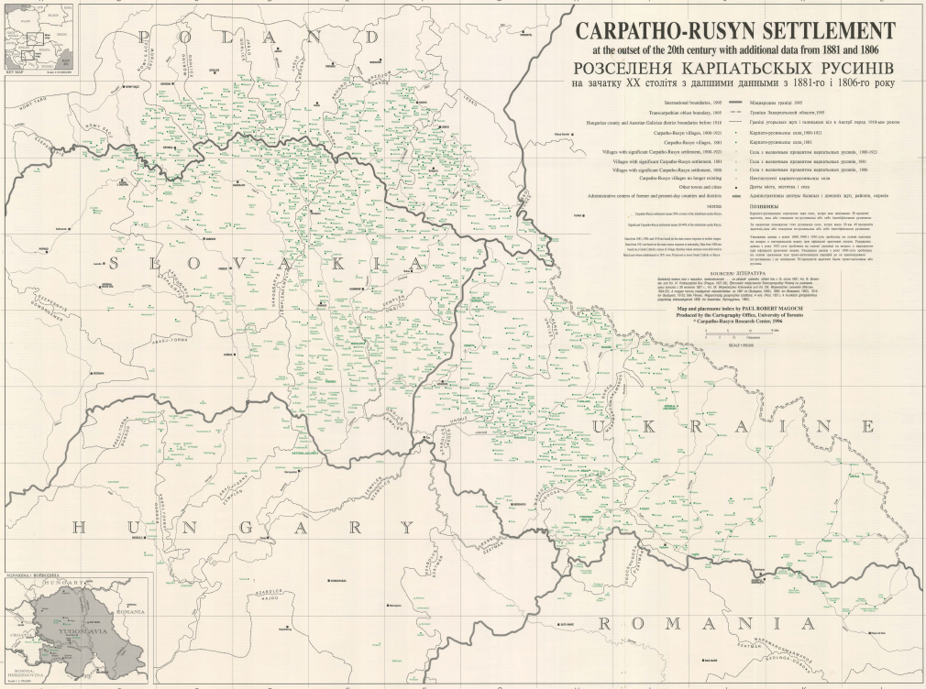
Multi-source tagging for Rusyn

Slide 37
Multi-source tagging for Rusyn
Rusyn: Slavic minority language, several regional dialects
Corpus of Spoken Rusyn:
Transcribed speech from different areas
Written in Cyrillic script
To be annotated: morphosyntactic tagging
но | безівно | як | він | дезь | го | убили | у | вовкаx | .
INTJ | ADV | PRON | PRON | PRON | PRON | VERB | ADP | NOUN | PUNCT
 |  | PronType=Int | Case=Nom | PronType=Int | Case=Acc | Mood=Ind |  | Case=Loc
 |  |  | Gender=Masc |  | Gender=Masc | Number=Plur |  | Gender=Masc
 |  |  | Number=Sing |  | Number=Sing | Tense=Past |  | Number=Plur
 |  |  | Person=3 |  | Person=3
 |  |  | PronType=Prs |  | PronType=Prs
Yves Scherrer & Achim Rabus (2017). Multi-source morphosyntactic tagging for Spoken Rusyn. In Proceedings of VarDial 2017.

Slide 38
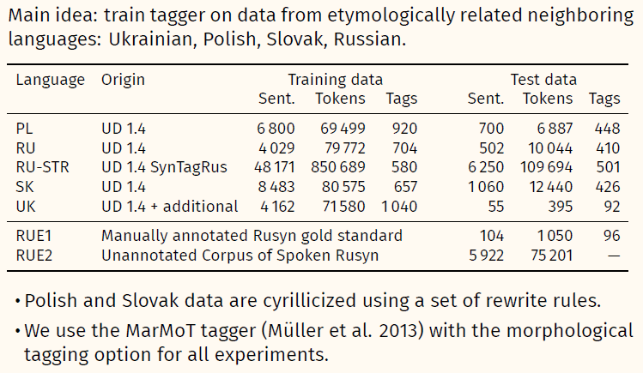
Data

Slide 39
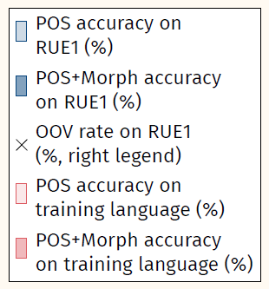
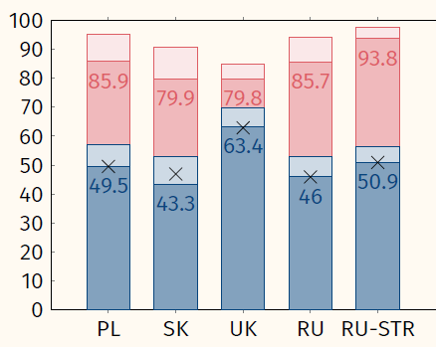
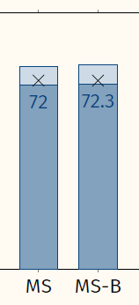
Results
MS: Concatenate training data from PL, SK, UK, RU, RU-STR, train single tagger
MS-B: with added word clusters

Slide 41
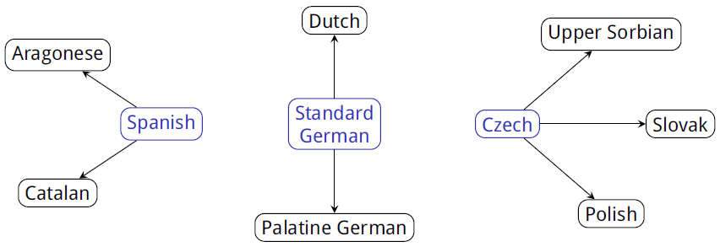
Relexicalization with cognate matching
Goals:
Don’t use any bilingual resources (dictionaries, parallel corpora)
Don’t do any manual annotation work
But restrict experiments to closely related languages
Comparable raw text for all languages is available (Wikipedia)

Slide 42
Cognate matching
Approach 1 (BI-SIM):
For each word of the HRL, find the most similar LRL word, then relexicalize the HRL tagger
Approach 2 (CSMT):
Train a model of language relatedness with the word pairs from approach 1
For each HRL word, find the most similar LRL word according to this model, and relexicalize the HRL tagger
Approach 3 (Context):
Train contextual similarity model using the word pairs from approach 2 as seed lexicon
Find additional word pairs with contextual similarity and relexicalize the HRL tagger

Slide 43
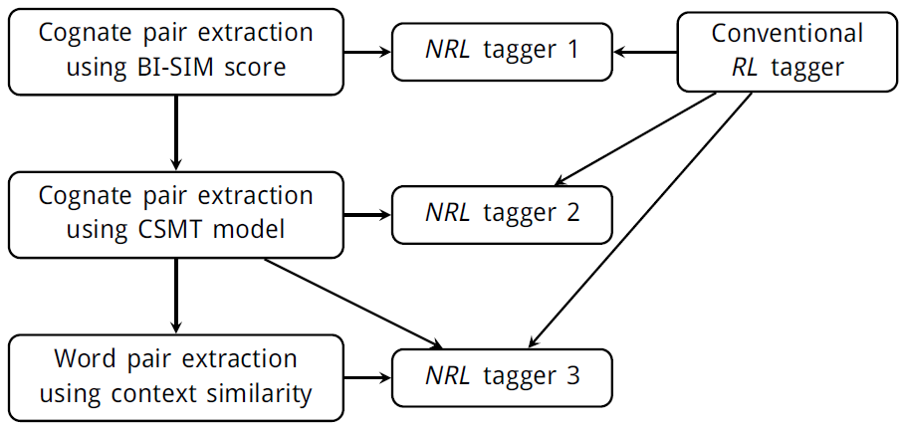
Cognate matching
Y. Scherrer & B. Sagot (2014). A language-independent and fully unsupervised approach to lexicon induction and part-of-speech tagging for closely related languages. In Proceedings of LREC.

Slide 44
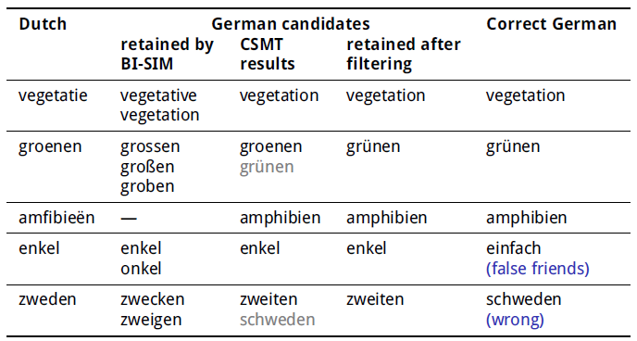
Examples (Dutch-German)

Slide 45
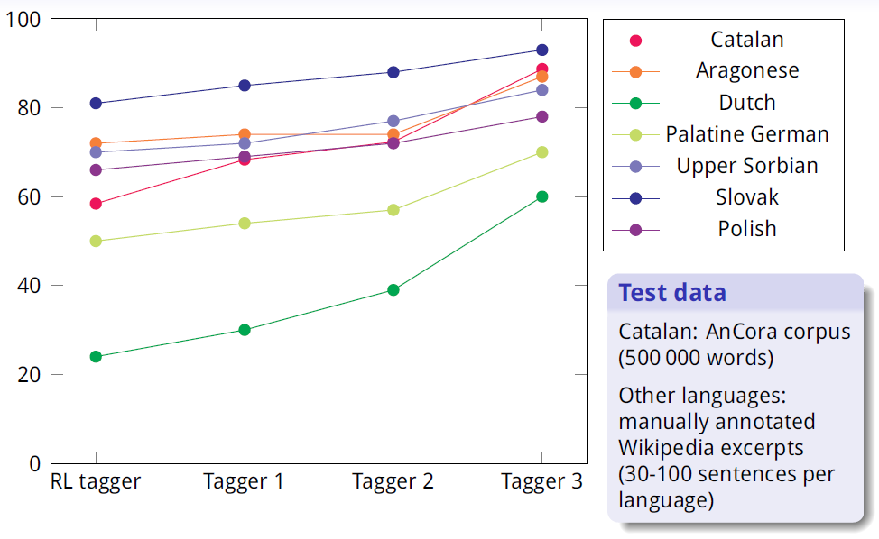
Cognate matching – Results

Slide 46
Cognate matching
Monolingual datasets
LRL | Tokens | HRL | Tokens
CA | 140M | ES | 432M
AN | 5.4M
NL | 0.5M | DE | 613M
PFL | 0.3M
HSB | 0.9M | CS | 86M
SK | 30M
PL | 206M

Slide 47
Cognate matching
Cognate matching needs to be
language-pair-dependent (approach 2 vs approach 1)
enhanced by semantic information (approach 3 vs approach 2)
Problems:
Ambiguity handling: assumed 1-1 correspondence for relexicalization
Tokenization differences: assumed 1-1 correspondence for relexicalization
Germanic languages perform poorly: compounds? spelling? data size?

Slide 49
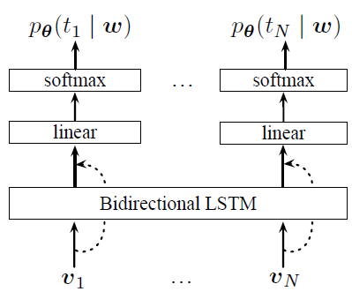
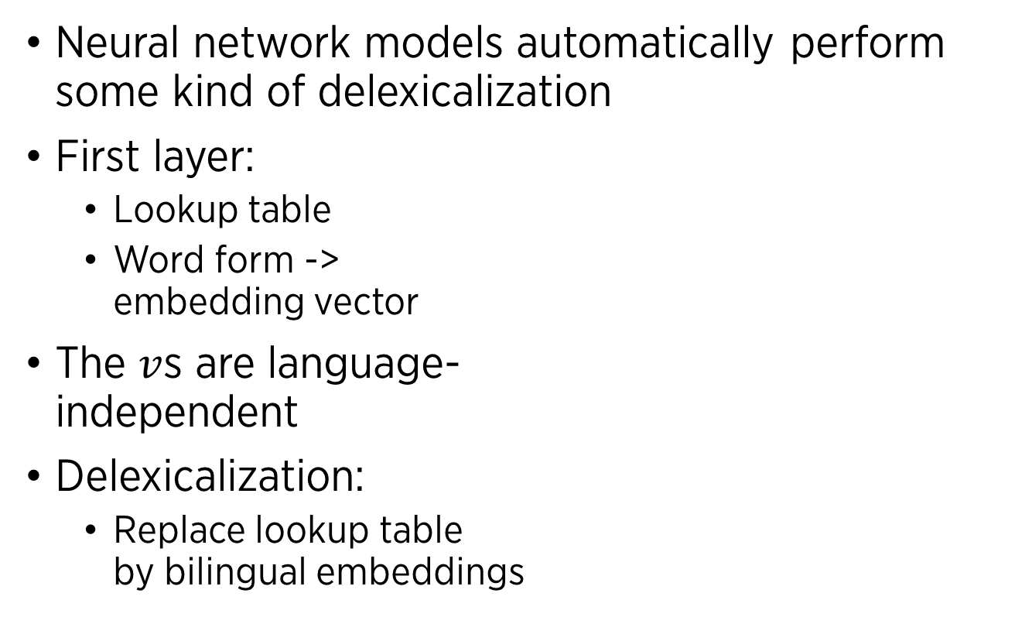
Neural network tagging and parsing
Neural network models automatically perform some kind of delexicalization
First layer:
Lookup table
Word form -> embedding vector
The $v$s are language- independent
Delexicalization:
Replace lookup table by bilingual embeddings

Slide 50
What type of word embeddings?
Standard word embeddings
Each distinct word form is considered an atomic entity that gets its own embedding vector based on context
Character-level word embeddings / “character embeddings”
Each word form is split into its characters
A recurrent or convolutional network is trained to predict the character sequence
A summary of the character embeddings (e.g. pooling) is fed to the subsequent layers
Such embeddings represent word-internal structure

Slide 51
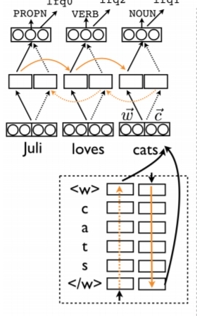
What type of word embeddings?
Common wisdom:
Both types of embeddings are helpful because they encode different aspects of the data
Concatenate both vectors
What about cross-lingual transfer models?
Cross-lingual word embeddings require large corpora (+ dictionaries)
What about character embeddings?

Slide 52
Impact of different embedding types
On average, character embeddings are much more helpful than word embeddings
Language | w | c | w + c
ar | 95.48 | 98.68 | 98.91
bg | 95.12 | 97.89 | 98.02
cs | 93.77 | 96.38 | 97.8
da | 91.96 | 95.12 | 96.19
de | 90.33 | 90.02 | 92.64
en | 92.1 | 91.62 | 94.46
es | 93.6 | 93.06 | 95.12
eu | 88 | 92.48 | 94.7
fa | 95.31 | 95.82 | 97.19
fi | 87.95 | 90.25 | 94.85
fr | 94.44 | 94.39 | 95.8
Language | w | c | w + c
he | 93.97 | 93.74 | 95.79
hi | 95.99 | 93.4 | 96.23
hr | 89.24 | 95.32 | 94.76
id | 90.48 | 91.37 | 93.11
it | 96.57 | 95.62 | 97.59
nl | 84.96 | 89.11 | 93.32
no | 94.39 | 95.87 | 97.57
pl | 89.73 | 95.8 | 96.41
pt | 94.24 | 95.96 | 97.53
sl | 91.09 | 96.87 | 97.55
sv | 93.32 | 95.57 | 96.36
B. Plank, A. Søgaard, Y. Goldberg: Multilingual part-of-speech tagging with bidirectional long short-term memory models and auxiliary loss. ACL 2016.

Slide 53
Cross-lingual tagging with character embeddings
Use related languages
Adapt the HRL tagger to LRL by including a small number of annotated LRL sentences
R. Cotterell & G. Heigold (2017): Cross-lingual Character-Level Neural Morphological Tagging. Proceedings of EMNLP.

Slide 54
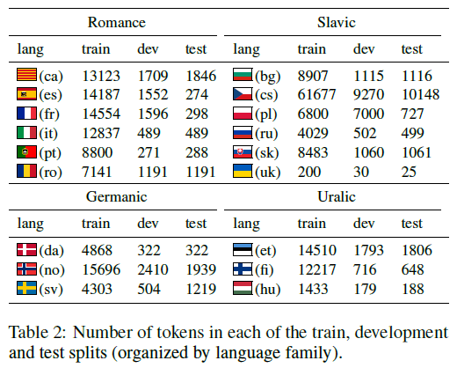
Cross-lingual tagging with character embeddings

Slide 55
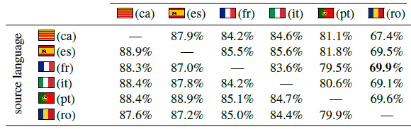
Cross-lingual tagging with character embeddings
Results for Romance languages (100 LRL training sentences):

Slide 56
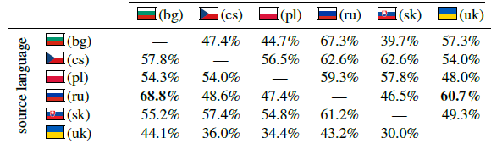
Cross-lingual tagging with character embeddings
Results for Slavic languages (100 LRL training sentences):

Slide 57
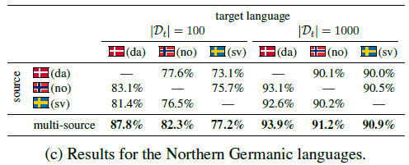
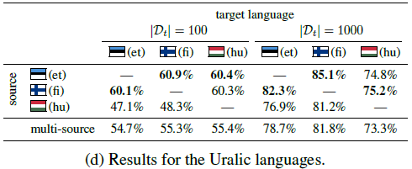
Cross-lingual tagging with character embeddings
Results for Northern Germanic languages:
Results for Uralic languages:

Slide 58
Cross-lingual tagging with character embeddings
No parallel data, no dictionary mappings required
However, small amount of LRL training data required
Results not impressive
Some missing baselines:
Train on only 100 LRL sentences, without HRL data
Train only on HRL data without LRL sentences
Cross-lingual character embedding mappings?

